Slide 1
Equitable Access to the Ballot: Disability Rights and Voting
Barbara Beckert
September 2022
.
Notes:
Barbara

Slide 2
The Struggle for Equitable Access to Voting: An Update from the Frontlines
About the disability vote
Historical barriers and new barriers
Strategies to protect and defend voting rights
Know your rights: voting rights and accessibility
Partnering
Resources
Notes:
Disability Voting Rights Week

Slide 3
About Disability Rights Wisconsin
DRW is the federally mandated Protection and Advocacy system for Wisconsin charged with protecting the rights of people with disabilities.
DRW helps protect the voting rights of people with disabilities, as required by the Help America Vote Act (42 U.S.C. § 15461 (2002))
Contact the DRW Voter Hotline for assistance or questions about voting. Open year round. 844-347-8683 / info@disabilityvote.org
Join the Wisconsin Disability Vote Coalition, coordinated by DRW and BPDD: https://disabilityvote.org/
Notes:
Barbara

Slide 4
Wisconsin Disability Vote Coalition
The WDVC is a non-partisan effort to help ensure full participation in the entire electoral process of voters with disabilities, including registering to vote, casting a vote, and accessing polling places.
The Coalition is coordinated by Disability Rights Wisconsin and the Wisconsin Board for People with Developmental Disabilities. Members include people with disabilities, over 40 community agencies, and other partners.
https://disabilityvote.org/
Notes:
Barbara

Slide 5
The Disability Vote
Approximately 23% of the electorate in the November 2020 election were individuals with some type of disability, according to AAPD.
This is a diverse group of voters: people with sensory disabilities, intellectual and developmental disabilities, physical disabilities, mental health disabilities, complex medical needs, and chronic health conditions.
Many older adults have disabilities acquired through aging, although they may not formally identify as a person with a disability.
People with disabilities are underrepresented at the polls. The Rutgers University Fact Sheet on Disability and Voter Turnout in the 2020 Elections notes an 11.4% gap in voters with and without disabilities and cites if people with disabilities voted at the same rate as people without disabilities, there would 1.75 million more voters.
Notes:
American Association of people with disabilities

Slide 6
Major barriers, historically
Accessibility concerns
Lack of Photo ID (high percentage of non-drivers)
Lack of Transportation (hard to get to DMV)
Failure to provide accommodations; limited awareness of accommodations
Limited access to internet and technology (digital divide)
Housing insecurity, group home or institutional setting
Lack of training for poll workers
Confusion about voting rights, including for people under guardianship and those with criminal convictions
Stigma and discrimination

Slide 7
Post 2020 Election Barriers
New bills proposing new barriers and restrictions
Absentee voting
Indefinitely confined voters
Nursing home/ group home voting
Restricting assistance
More restrictions for those w/felony convictions
Constitutional amendments
Many investigations
Indefinitely confined voters & voting rights of people in nursing homes targeted
Attacks on integrity of elections and on election officials
Litigation
Frequent changes in election law and processes
Notes:
Chaos and confusion

Slide 8
Impact on Voters with Disabilities of Proposed Bills
Prohibit Clerks / WEC and other groups from sending absentee ballot applications to all eligible voters
New restrictions for Indefinitely Confined voters. Ex. Eliminates option to receive absentee ballots automatically for every election.
Prohibited private funds used to assist municipal elections – like when funding was provided to communities for COVID-19 safety protocols
Limited who could assist with returning an absentee ballot
New restrictions on use of drop boxes
Prohibit clerks from correcting (“curing”) a defect on a completed absentee ballot return envelope, such as partial address on the envelope
Would be a felony for nursing home staff to offer assistance with voting to residents
Notes:
SS Voters with disabilities a high utilization of absentee voting; higher percentage rely on assistance to complete, mail and deliver their ballot.

Slide 9
Strategies to protect and defend voting rights
Notes:
BB

Slide 10
Teigen v WEC
Plaintiffs filed a motion asking the court to: 1) eliminate the ability of municipalities and counties to use drop boxes to collect absentee ballots; 2) require voters using absentee ballots to personally hand over their ballot to the clerk.
Law Forward intervened on behalf of DRW along with our partners LWV of Wisconsin and Wisconsin Faith Voices.
DRW provided affidavits from 20 voters as well additional family members and disability agencies re how the ban on assistance with mailing of ballots and return of ballots would disenfranchise voters with disabilities
Our Voices Our Votes https://disabilityrightswi.org/wp-content/uploads/2022/04/DRW-Our-Voices-Our-Votes-4-2022-acc.pdf
Notes:
January 2022: Waukesha County Circuit Court Judge Michael Bohren issued a summary judgment decision, in court, that absentee ballot drop boxes and “ballot harvesting” are not permitted in state law. Judge Bohren also ruled that the Wisconsin Elections Commission (WEC) guidance documents on absentee ballot drop boxes, issued in 2020, should have gone through the rules process. Stated the only the voter can return or mail their ballot
SCOW of WI did respond directly to our argument regarding the protections in federal law. Also did not address the issue of assistance with mailing a ballot.

Slide 11
Carey v WEC
August 31: Chief U.S. District Judge James Peterson’s order: Confirmed the federal rights of the four plaintiffs and of all disabled Wisconsin voters to receive assistance from a person of their choice to return their absentee ballots. WEC was required to provide written instructions to all Wisconsin clerks stating that:
Any Wisconsin voter who requires assistance with mailing or delivering their absentee ballot to the municipal clerk because of a disability must be permitted to receive such assistance by a person of the voter’s choice, other than the voter’s employer or agent of that employer or officer or agent of the voter’s union. Link to Guidance:
Guidance on Absentee Ballot Return Options Under the Federal Voting Rights Act | Wisconsin Elections Commission
Watch for DRW and DVC document explain absentee ballot return assistance for November 8th election.

Slide 12
Speaking Out for Voting Rights
Elevate the voices of voters impacted
Testimony at legislative hearings & WEC meetings
Press events
Sign on Statements
Letters to the editor
Earned media
Voter statements (Voting Rights Are Human Rights)
Surveys
Social media, including voter spotlights
DRW/ DVC provides legislative analysis, support, and advocacy training
Coalition work and partnerships
Notes:
BB ?
Virtual hearings were helpful. Accommodations important moving forward
We need to work together to engage, educate grassroots and ensure that more people speak out,

Slide 13
Training & Outreach to Voters, Service Providers, Election Officials
Know your rights: education re federal & state laws
Guardianship and voting rights
Voting Rights of people with criminal convictions
Voting rights of care facility residents
Collaboration with allies
Partner with WEC to provide resources and training on accessibility and accommodations; polling place accessibility audits

Slide 14
Federal Voter Accessibility Laws
Voting Rights Act (VRA) of 1965
Voting Accessibility for the Elderly & Handicapped Act (VAEHA) of 1984
The Americans with Disabilities Act (ADA) of 1990
National Voter Registration Act (NVRA or Motor Voter) of 1993
Help America Vote Act (HAVA) of 2002
Notes:
SB

Slide 15
Voting Rights Act
Provides for voters who need assistance to vote by reason of blindness, disability, or inability to read or write.
Any such voter may be given assistance by a person of the voter's choice, other than the voter's employer or agent of the employer or officer or agent of the voter's union.
Prohibits conditioning the right to vote on a citizen being able to read or write, attaining a particular level of education, or passing an interpretation “test.”

Slide 16
Voting Accessibility for the Elderly and Handicapped Act of 1984
Requires accessible polling places in federal elections for elderly individuals and people with disabilities, pre-dating the ADA.
Where no accessible location is available to serve as a polling place, voters must be provided an alternate means of voting on Election Day.
Creates the right for voters to request to be moved up in line. Voters who are not moved to the front of the line must be in some way accommodated.
Notes:
SB

Slide 17
ADA and Voter Access
Title II of the ADA requires state and local governments (“public entities”) to ensure that people with disabilities have a full and equal opportunity to vote.
The ADA’s provisions apply to all aspects of voting, including voter registration, site selection, and the casting of ballots, whether on Election Day or during an early voting process.
Every option available to voters must be fully accessible to all voters, including in person and remote voting options.
Accommodations, like curbside voting and moving up in line, should be used and must be used in some situations.
Notes:
SB July 26 1990

Slide 18
National Voter Registration Act - Motor Voter and Disability
Aims, among other things, to increase the historically low registration rates of persons with disabilities.
Requires all offices that provide public assistance or state-funded programs that primarily serve persons with disabilities to also provide the opportunity to register to vote in federal elections.
Wisconsin is one of 6 states exempt from Motor Voter, as we have same day registration at polling places.
Always a best practice, even in states that offer same day registration.
The National Voter Registration Act Of 1993 (NVRA) (justice.gov)

Slide 19
Help America Vote Act
Guarantees all voters the right to a private and independent ballot.
Jurisdictions responsible for conducting federal elections have to provide at least one accessible voting system for persons with disabilities at each polling place.
The accessible voting system must provide same opportunity for access, participation, privacy and independence.
Notes:
SB

Slide 20
Wisconsin Accessibility Provisions
List of Wisconsin Accessibility Provisions
5.25(4)(a) Each polling place shall be accessible to all individuals with disabilities…..
5.25(4)(d) No later than June 30 of each odd-numbered year, the commission shall submit a report on impediments to voting faced by elderly and handicapped individuals to the appropriate standing committees …..In preparing its report under this paragraph, the commission shall consult with appropriate advocacy groups representing the elderly and handicapped populations
5.25(5)(b) Alternative Polling Place
6.79(8) Accommodation State Name and Address
6.82(1)(a) Curbside Voting
6.82(2) Assistance marking ballot
6.86(2)(a) Indefinitely Confined
Notes:
SB TSBhe Link will display a comprehensive list of Wisconsin accessibility provisions as of 2021. Those listed are some of the most frequently cited.

Slide 21
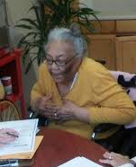
Voter Rights
You have the right to
Vote privately and independently
Access the polling place, including an accessible route to enter the building
Assistance mailing or returning your ballot.
Assistance marking your ballot. If voting in person, you can bring someone with you or ask a poll worker for assistance. Poll workers are required to assist a voter upon request.
Note: You cannot receive assistance from your employer or from your union representative.
Notes:
DENISE

Slide 22
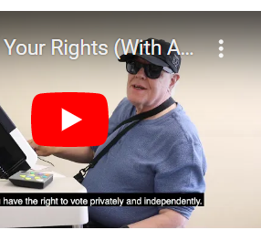
Voter Rights Video and Fact Sheet
For information about voting rights, watch the Disability Vote Coalition video “Know Your Rights” before you vote in person: disabilityvote.org/2019/know-your-rights/
Voting Rights fact sheet: https://disabilityvote.org/2021/voting-rights-fact-sheet/
Notes:
DENISE

Slide 23
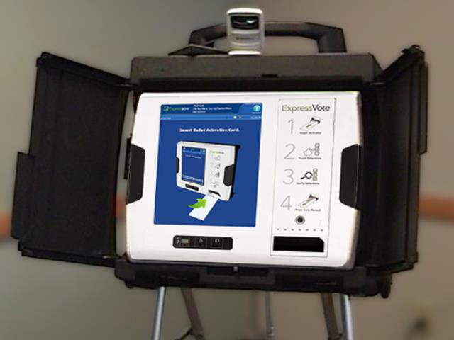
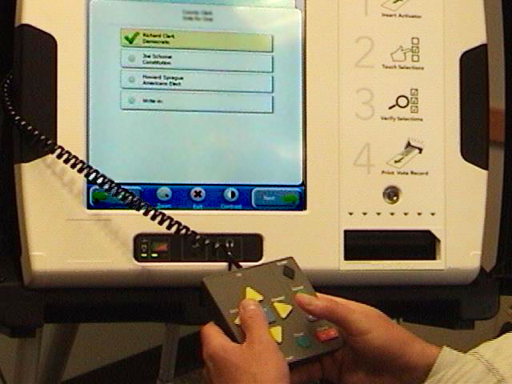
Voter Rights-Accessible Voting Machines
You have the right to use an accessible voting machine at your polling place.
All polling places are required by law to have an accessible voting machine. Note: The law does not require this for early in-person absentee voting.
Anyone can (and should) use an accessible voting machine.
Learn more about the machines at https://elections.wi.gov/accessible-voting-equipment
Notes:
DENISE

Slide 24
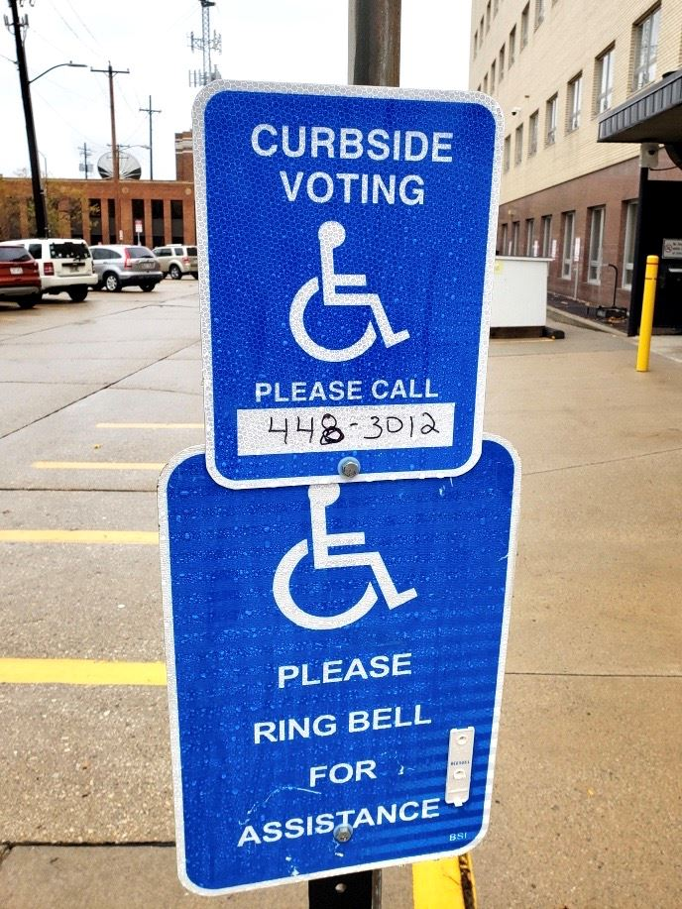
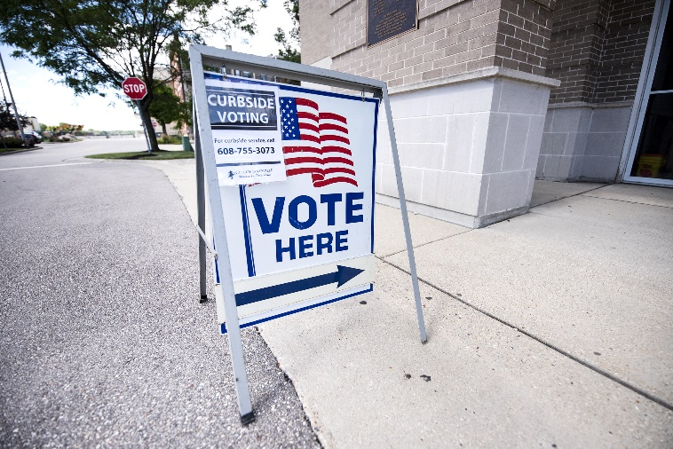
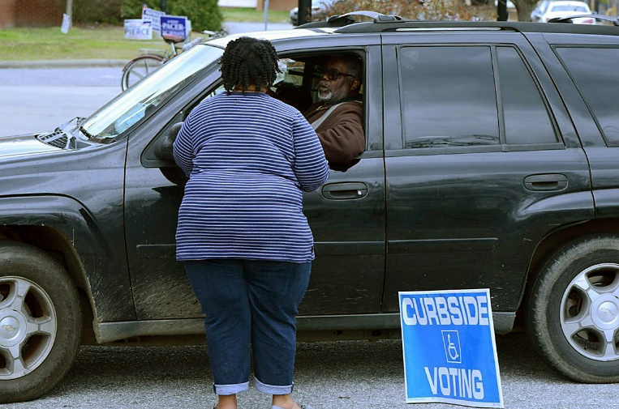
Voter Rights – Curbside Voting
If a voter cannot enter the absentee voting location or polling place due to disability, Wis. Stat. § 6.82(1) requires that curbside voting must be available.
Tip: contact your clerk in advance to discuss how to access curbside voting. (number to call, bell to ring, honk horn etc.)
Notes:
DENISE

Slide 25
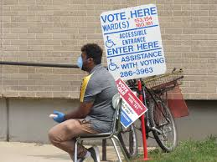
Voter Rights – Reasonable Accommodations
You have the right to ask for reasonable accommodations at the polling place including,
a chair to sit on
a signature guide
a magnifying glass
assistance stating your name and address
tools to help poll workers interact with deaf and hard of hearing voters such as pen and paper or an easel for announcements.
Notes:
DENISE

Slide 26
Voting and Guardianship
In Wisconsin, a person under guardianship retains the right to vote unless the court expressly removes it. Election officials, family members, guardians or others may not take away someone’s right to vote.
The Court’s decision regarding the right to vote is recorded on a court form called “A Determination and Order on Petition for Guardianship Due to Incompetency.” (GN-3170). A copy may be requested from Probate Court in their county (about $2.00 for a copy).
The court order will not say that the person has retained the right to vote, however, a box will be checked if the right has been removed.
Notes:
DENISE

Slide 27
Voting and Guardianship (cont.)
A person who has a guardian and has lost the right to vote may petition the court to restore their right to vote (Wis. Stat 54.64(2)(a)).
Resources about voting rights and guardianship, and restoring the right to vote are on the DRW website: disabilityrightswi.org/resource-center/guardianship-and-voting/

Slide 28
An Invitation: Partner with Us
Our shared goals:
Increase the number of disabled Wisconsinites who are registered to vote and who cast a ballot and participate in our democracy.
Ensure that voters with disabilities understand and assert their rights.
Advance policies and practices that support accessible and inclusive elections and oppose policies that create new barriers.
Choose from the menu of options for partnering with the disability community.
Notes:
Steph

Slide 29
Equity and the Disability Vote: Partnership Opportunities
Partner with a disability agency to hold a voter registration event. We can help you find a partner agency.
Examples:
Disability Vote Coalition – email info@disabilityvote.org
Aging and Disability Resource Centers (1 in each county)
Centers for Independent Living (8 centers)
Local Arc chapters
NAMI affiliates
Autism Society chapters
Notes:
Steph

Slide 30
Equity and the Disability Vote: Partnership Opportunities
Order or print Disability Vote Coalition materials from our website: disabilityvote.org
Add them to your resource table and share them in your community. Share with schools, colleges, group homes, senior centers, day programs, or as part of a food distribution or vaccine dissemination effort.
Our Voter Toolkit – 2022 Elections is a good starting point
2022 Election Postcards: View 2022 Postcards here.
2022 Election Posters: View 2022 Posters here.
Make Your Plan to Vote: Aug 9th Primary and Nov 8th Fall Election
Competency, Guardianship, and Voting in WIsconsin.
Notes:
Steph note that fact sheets can be printed

Slide 31
Increase awareness of Voting Rights and Accommodations
Voting Rights Fact Sheet:
View English Voting Rights fact sheet here (accessible pdf).
View Spanish Voting Rights fact sheet here (accessible pdf).
Know Your Rights Video
Report an Accessibility Concern to the WI Elections Commission: View report form here.
Refer voters to the Disability Rights WI Voter Hotline: 844-347-8683 / 844-DIS-VOTE
Notes:
Steph

Slide 32
Participate in polling place accessibility audits
WEC Election Day Polling Place Accessibility Review program
Audits are conducted by DRW staff, WEC staff, and temps.
Temps needed for the November elections.
WEC provides training and tablets for use, and participants are assigned polling places.
You must have your own transportation.
Notes:
Barbara

Slide 33
Partner with Us
Sign up for the Disability Vote Coalition e-newsletter at disabilityvote.org
Follow us on Facebook, Instagram and Twitter. Like and share our posts.
Join a Disability Vote Coalition Subcommittee. Email us at info@disabilityvote.org for information about our subcommittees:
Education and Outreach
Voting Rights and Accessibility
Advisory Group on Voting in Nursing Homes and Group Homes
Notes:
Barbara

Slide 34
Be an Ally
Use the accessible voting machine at your polling place.
If you are a poll worker, talk to your peers about how to increase use of accessible voting machine. Best practice is to offer it to all voters.
Ask your clerk about serving as a Special Voting Deputy for nursing homes and care facilities.
Provide captioning for videos and virtual events so they are accessible to deaf and hard of hearing.
Hold events at locations that are accessible.
Make your materials more accessible. Use sans serif font, 13 pt or larger font size, and high contrast colors.
Include disability related questions in candidate forums.
Notes:
Barbara

Slide 35
Next steps
What are 2 things you can commit to doing to support the disability vote?
Partner with the Disability Vote Coalition: https://disabilityvote.org/
Notes:
Barbara

Slide 36
Resources
DRW Voter Hotline: 844-DIS-VOTE/ 844-347-8683 email: info@disabilityvote.org
Disability Vote Coalition:
disabilityvote.org/ www.facebook.com/wisconsindisabilityvote/
Guardianship and Voting: disabilityrightswi.org/resource-center/guardianship-and-voting/
Accessible Voting, Wisconsin Election Commission: https://elections.wi.gov/voters/accessible-voting
The Americans with Disabilities Act and Other Federal Laws Protecting the Rights of Voters with Disabilities: www.ada.gov/ada_voting/ada_voting_ta.htm
List of Wisconsin Accessibility Provisions

Slide 37
Questions?

